Slide 1


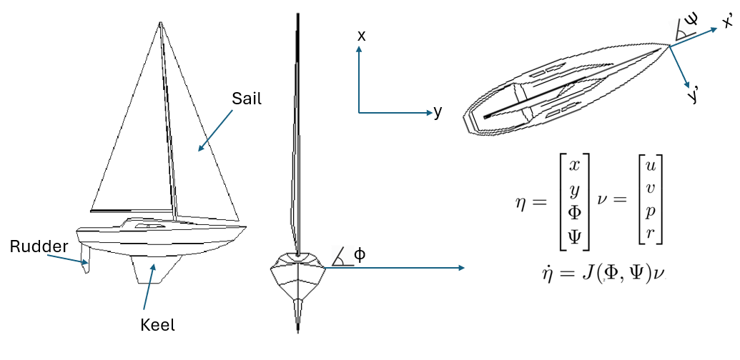
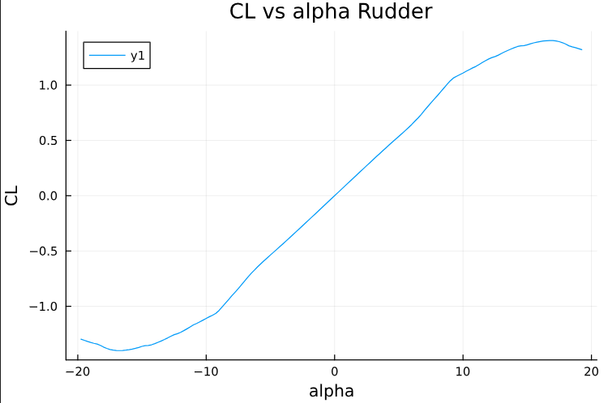
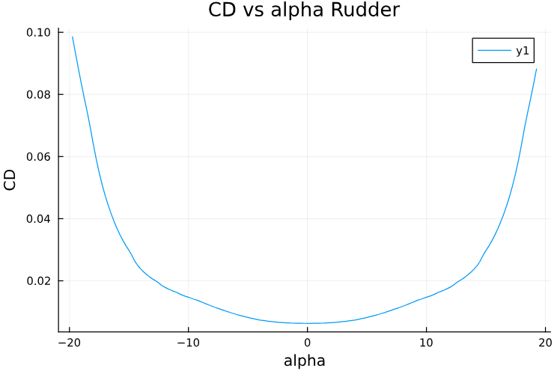
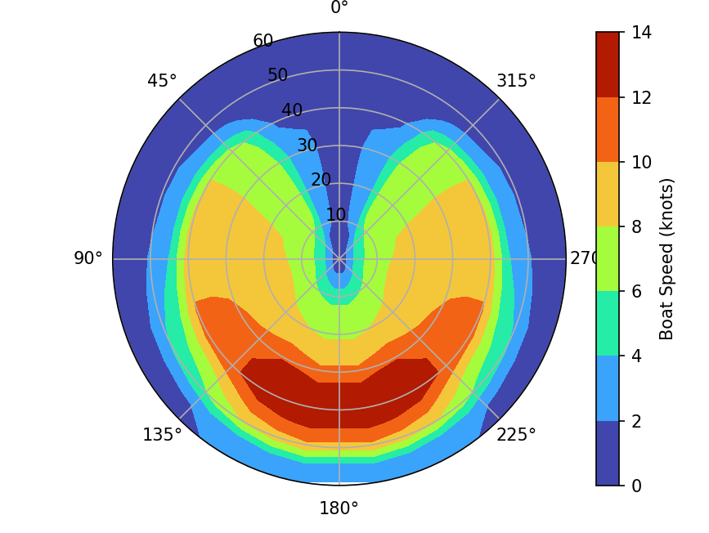
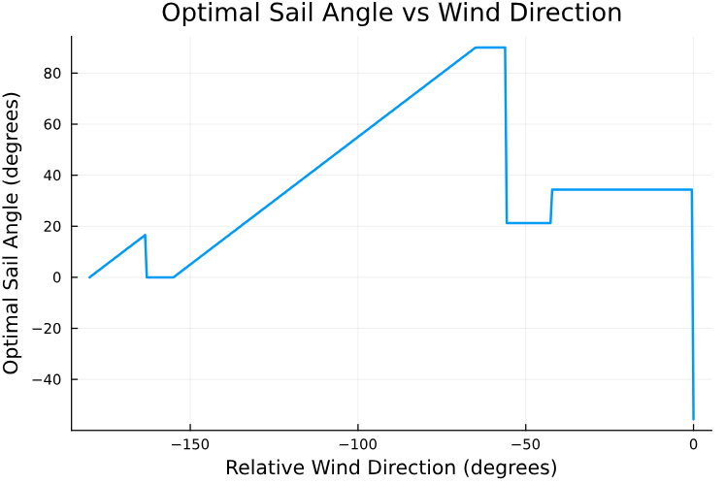
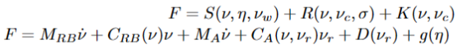
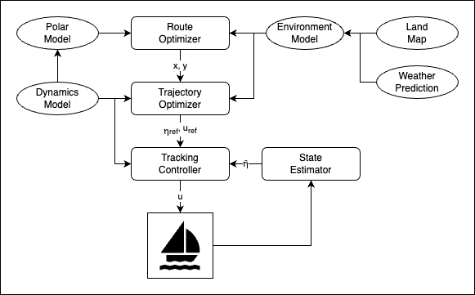
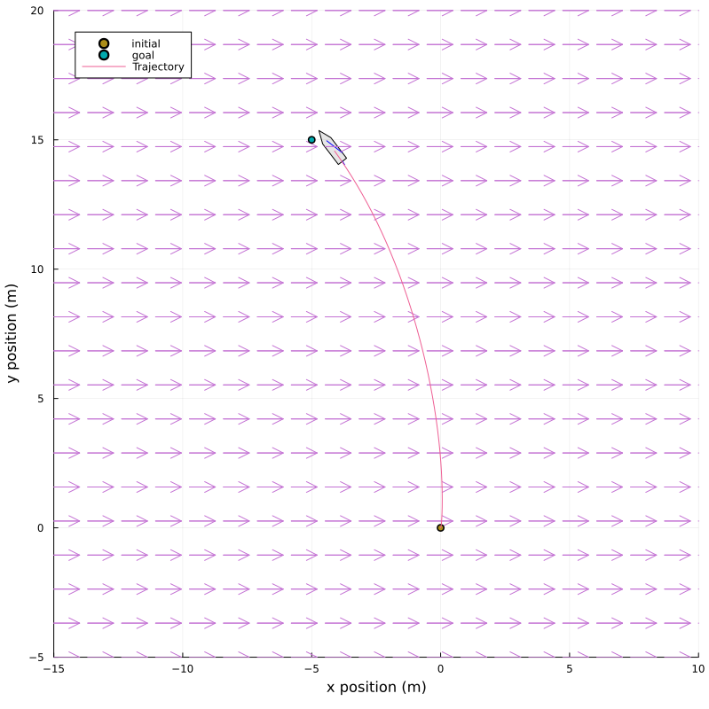
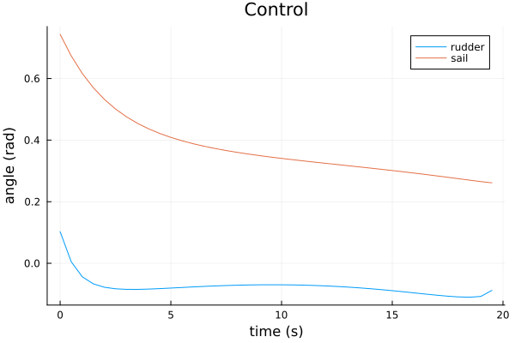
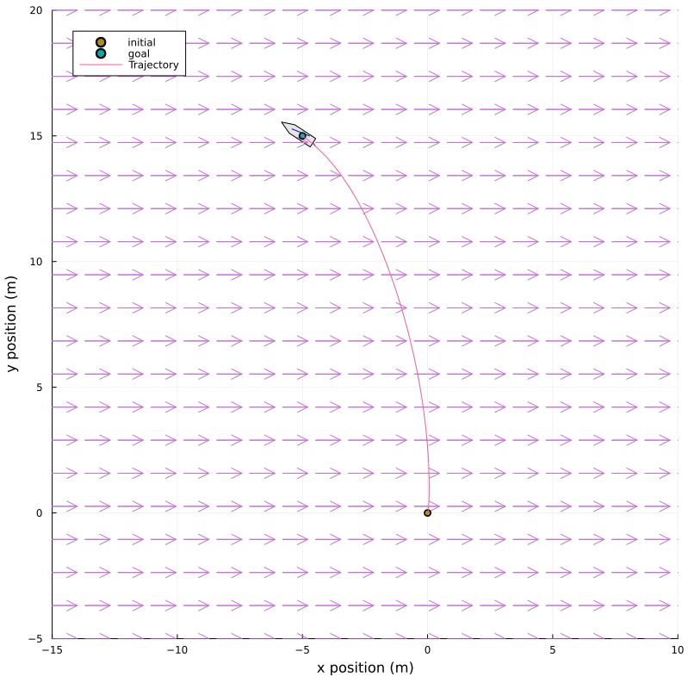
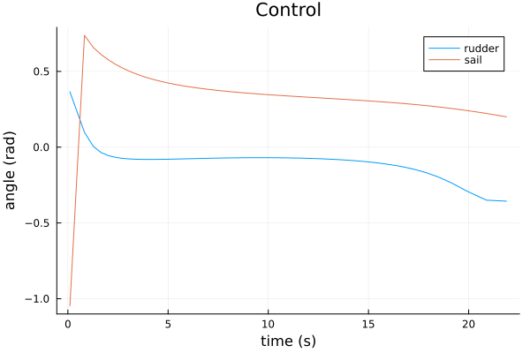
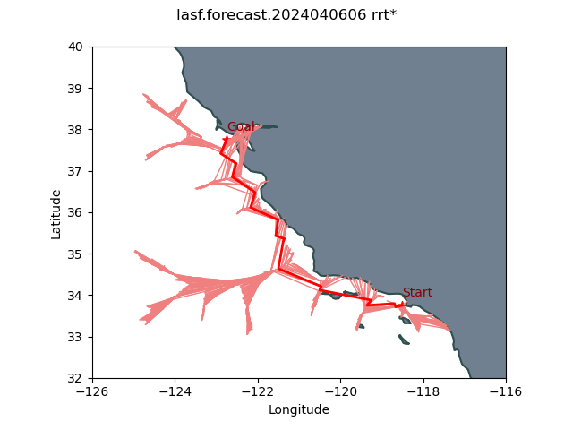
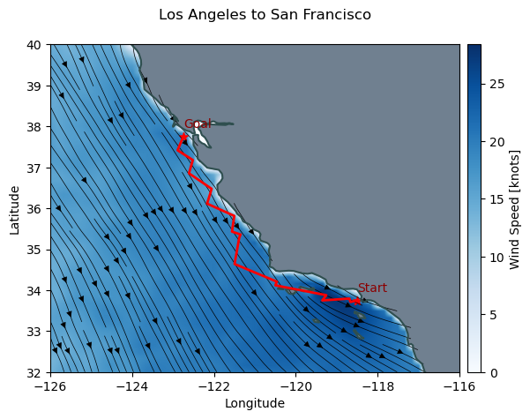
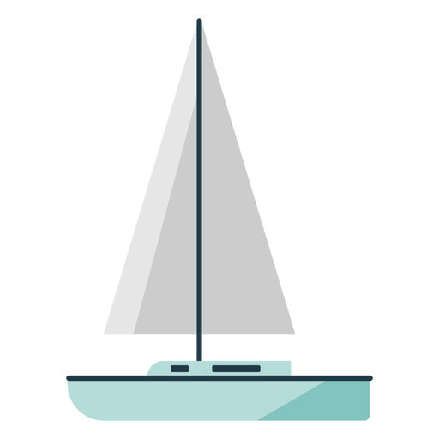


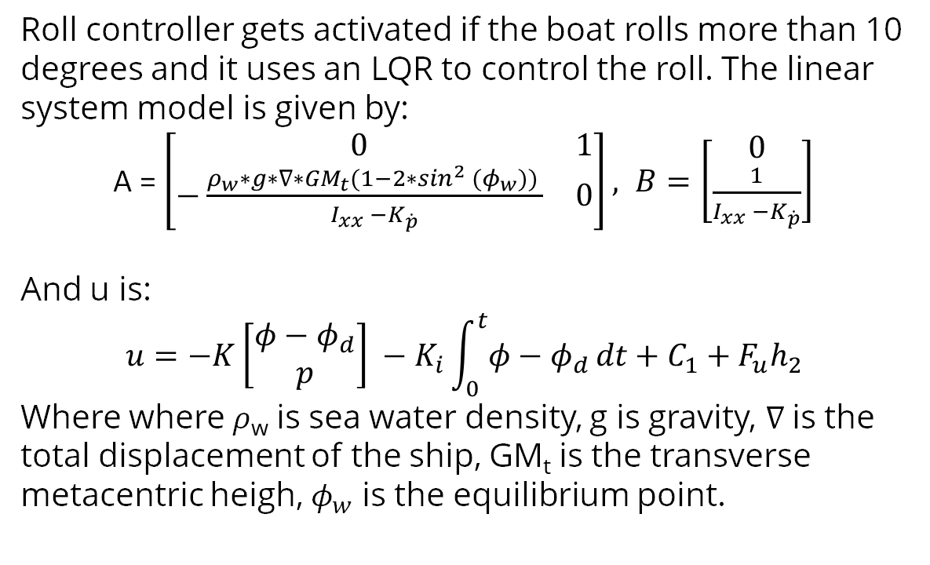
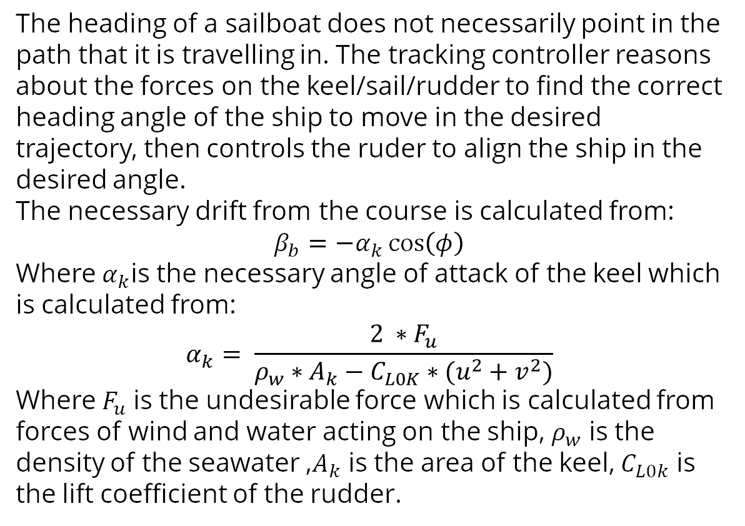
Autonomous Sailboat
Tae Rugh, Ben Spin, Samaksh Judson, Denis Alpay, Chris Suzuki
Motivation
Dynamics Model
Polar Model
In this project, we leverage weather predictions to develop an optimal control system for autonomous sailboats.
Autonomous sailboats can potentially offer a carbon-neutral solution for the shipping industry. Most importantly, autonomous sailboats provide a unique and interesting control problem because the dynamics are highly coupled to the environment and the control is underactuated.
We are modeling our sail, rudder, and keel as airfoils using NACA airfoil tools with correction terms.
Assumptions:
Yacht is rigid
Effect of waves are not modelled.
Added mass coefficients are modelled as constants.
System Overview
The environment is modeled with a land-ocean map and real-world weather prediction data. The sailboat dynamics are modeled as a 4 degree-of-freedom system with latitude, longitude, yaw, and roll.
We propose a controller with 3 levels: A global route optimizer, which uses RRT* to find an optimal route, a trajectory optimizer which uses direct collocation to find an optimal trajectory along the route, and a tracking controller which uses MPC to track the trajectory.
S, R, K – Sail, Rudder, and Keel Forces, RB is rigid body and A is added mass, M is mass matrix, C is Coriolis matrix , D is drag, g is Restoring Forces
Trajectory Optimizer
Course Controller
The figure above is a polar plot showing stable boat speed as a function of wind angle and wind speed. The maximum boat speed is determined by varying the sail angle for different wind angles and wind speeds. While plots generated using simulation data are smoother, they sometimes fail to capture real-world uncertainties.
The trajectory optimizer uses waypoints from the optimized route to generate an optimal reference trajectory for a local distance horizon. We implemented both direct collocation and iLQR.
We found that the direct collocation method was a better choice because we have a good initial guess from the route optimizer. Additionally, direct collocation enabled us to implement a time optimization such that the total time to reach the end goal doesn't have to be set manually.
The heading of a sailboat does not necessarily point in the path that it is travelling in. The tracking controller reasons about the forces on the keel/sail/rudder to find the correct heading angle of the ship to move in the desired trajectory, then controls the ruder to align the ship in the desired angle.
The necessary drift from the course is calculated from:
$$β_{b}=−α_{k}\cos\left(φ\right)$$
Where $α_{k}$is the necessary angle of attack of the keel which is calculated from:
$$α_{k}= \frac{2 ∗F_{u}}{ρ_{w}∗A_{k}−C_{L0K}∗(u^{2}+v^{2})}$$
Where $F_{u}$ is the undesirable force which is calculated from forces of wind and water acting on the ship, $ρ_{w}$ is the density of the seawater ,$A_{k}$ is the area of the keel, $C_{L0k}$ is the lift coefficient of the rudder.
Environment Model
We use oceanic weather data from the Global Forecast System wave model (GFSwave), provided by the National Oceanic and Atmospheric Administration (NOAA). From this, we can get forecasts to use for planning as well as historical data to use as a ground truth. This source provides many data variables for waves which we hope to incorporate into our model in the future, but currently we only use the wind velocity variables.
We also use a base map from Natural Earth to identify the land versus ocean. The route planner and trajectory optimizer use this data to avoid obstacles. The base map is available at varying levels of precision, which affects algorithm speed.
Direct Collocation
Route Optimizer
Roll Controller
Global route optimization is done using the classic sampling-based planning algorithm, RRT*. The cost-to-go between nodes is the travel time, which is calculated by integrating the boat speed from the polar model, subject to the time-varying weather forecast.
Roll controller gets activated if the boat rolls more than 10 degrees and it uses an LQR to control the roll. The linear system model is given by:
A = $\left[\begin{matrix}0 & 1 \\ −\frac{ρ_{w}∗g∗∇∗GM_{t}(1−2∗sin^{2} (φ_{w})) }{I_{xx} −K_{\dot{p}}} & 0\end{matrix}\right], B=\left[\begin{aligned}0 \\ \frac{1}{I_{xx} −K_{\dot{p}}}\end{aligned}\right]$
And u is:
$$u=−K\left[\begin{aligned}φ−φ_{d} \\ p\end{aligned}\right] −K_{i}\int_{0}^{t}{φ−φ_{d }dt}+C_{1}+F_{u}h_{2}$$
Where where 𝜌_{w} is sea water density, g is gravity, $∇$is the total displacement of the ship, GM_{t} is the transverse metacentric heigh, $φ_{w}$ is the equilibrium point.
Time-optimized Direct Collocation
Future Work
Each of these systems described have been built and work on their own. Our next objective is to link them together into a cohesive controller framework as described in the system overview. Additionally, we plan to build an optimal tracking controller using model-predictive control, and compare this system to the course/roll controller results.
In the future, beyond the scope of this class project, we would like to simulate the system with model mismatch and measurement noise, implement a state-estimator, and do a robustness analysis.

